Slide 1
What is Data Science?

Slide 2
What do you think is data science?
Dealing with Gazzilion-Bytes?
Computing in the cloud?
Neural Network / Deep Learning?
Probability and statistics?
Answering questions using large collections of data?

Slide 3
The scientific method
Explore the data
Make a hypothesis / model
Use data to tune and validate/refute the hypothesis
Repeat.

Slide 4
Interpretability
Some modeling can be done without interpretation:
Object detection using Neural Networks.
In most cases interpretation is important.
Gives confidence.
Can justify the prediction:
evidence for predicted disease.

Slide 5
Data Science is an Inter-disciplinary
Most Data Science projects have two types of researchers:
Domain experts: people with expertise in the particular domain:
Collect the data.
Label / annotate the data.
Formulate the questions.
Methods experts: Statisticians/Computer Scientists/Mathematicians. Role:
Use data to answer questions.
Communication skills are key!

Slide 6
Some real life examples of data science

Slide 7
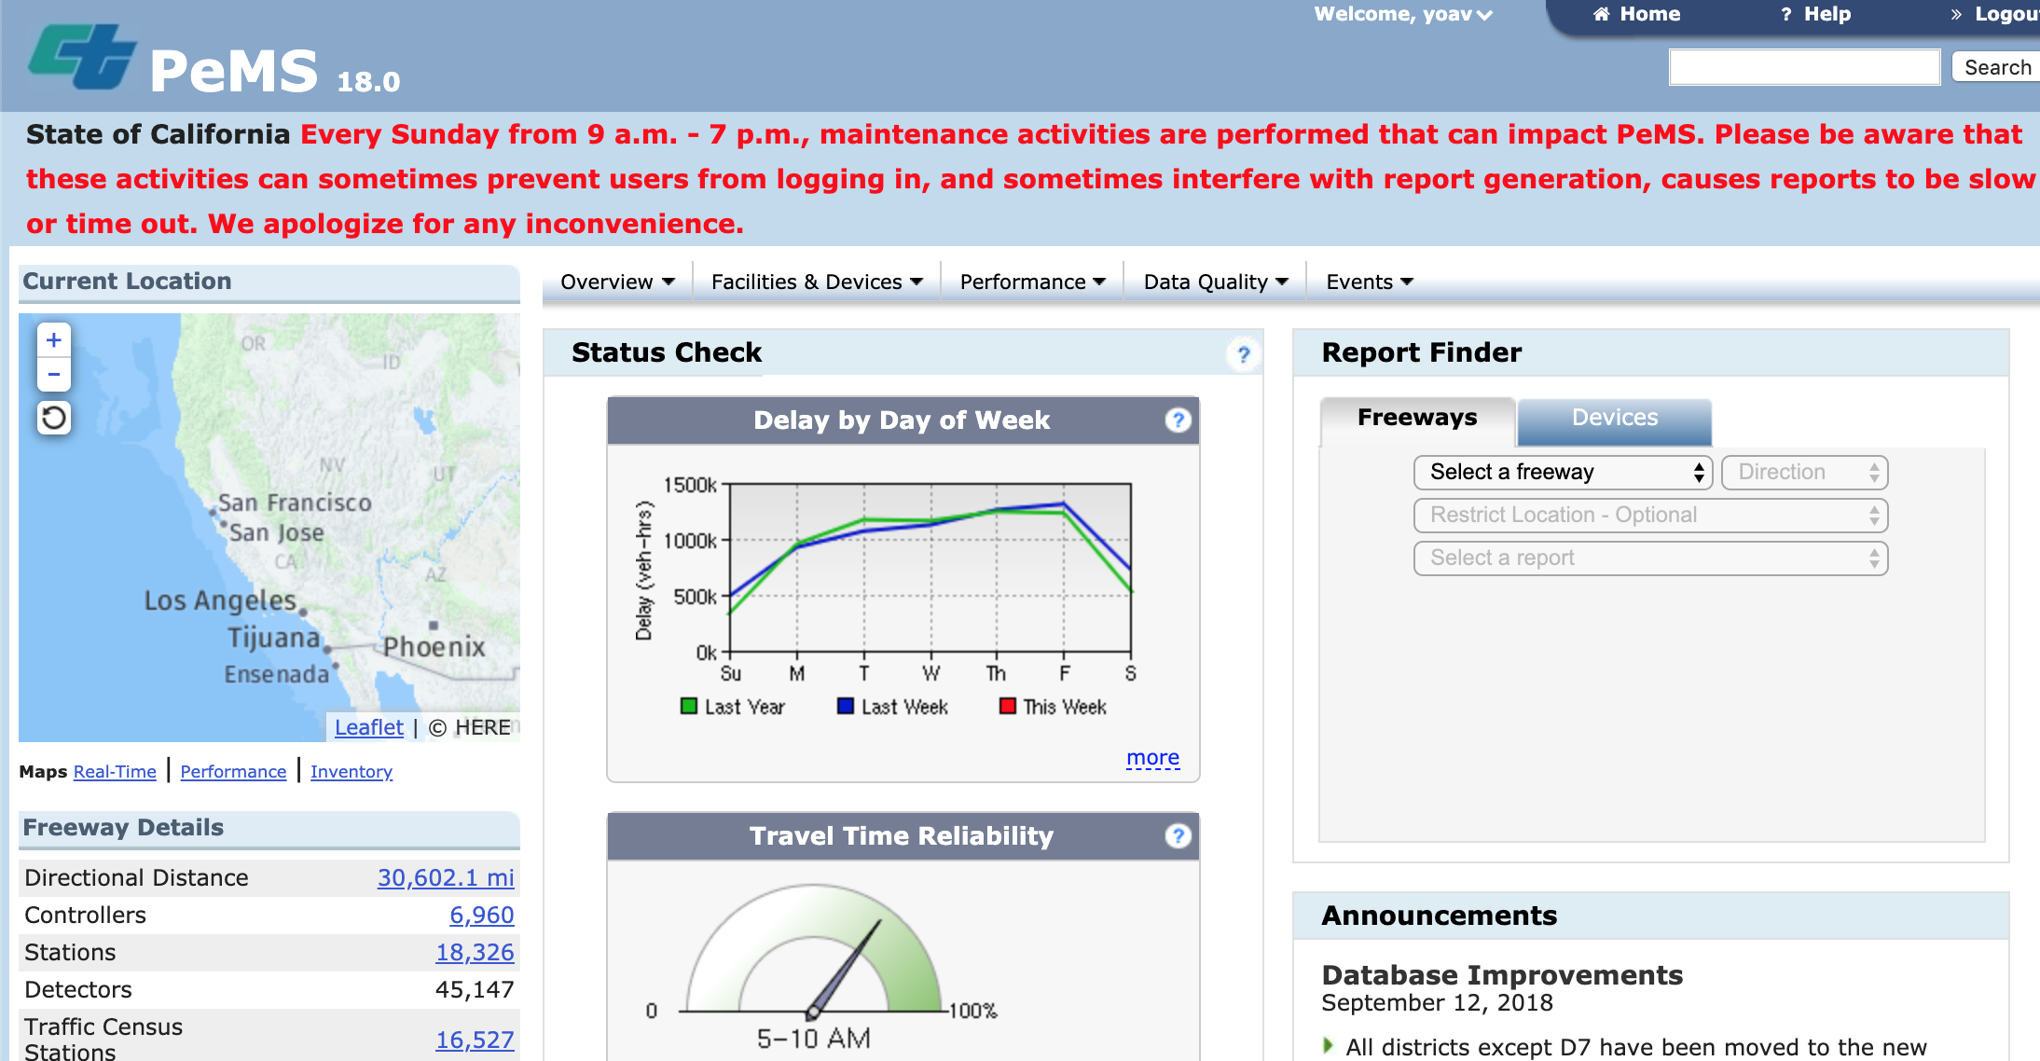
Caltrans: PeMS (Performance measurement system)

Slide 8
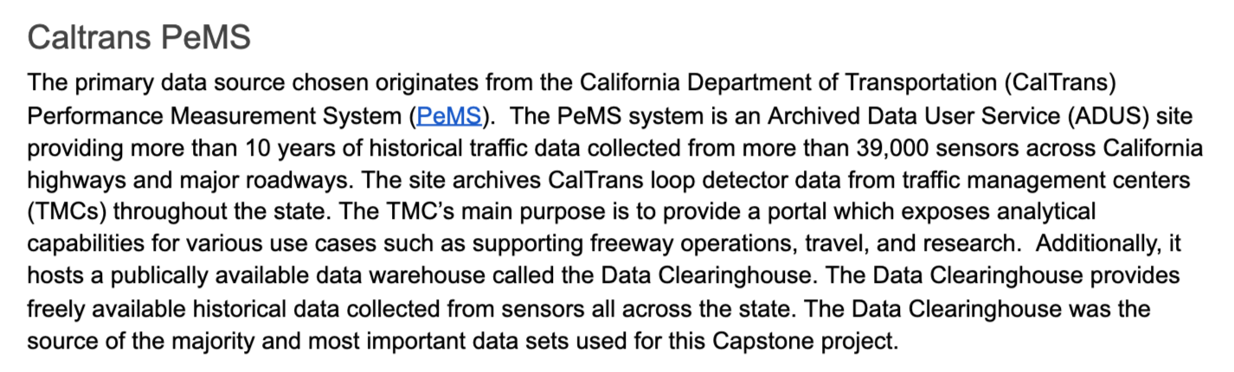
MAS-DSE Capstone Project, 2016 Kevin Dyer, John Gill III, Conway Wong

Slide 9
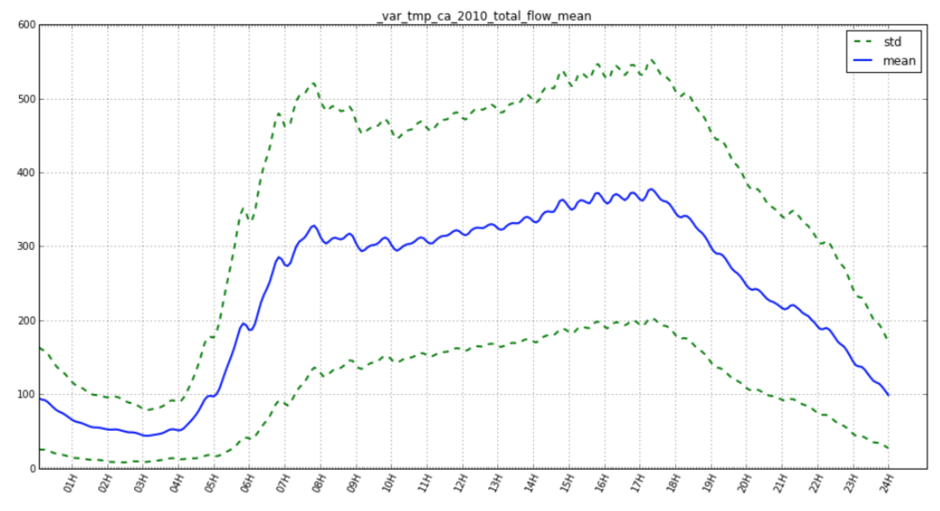
Mean and STD of total flow (cars per minute)

Slide 10
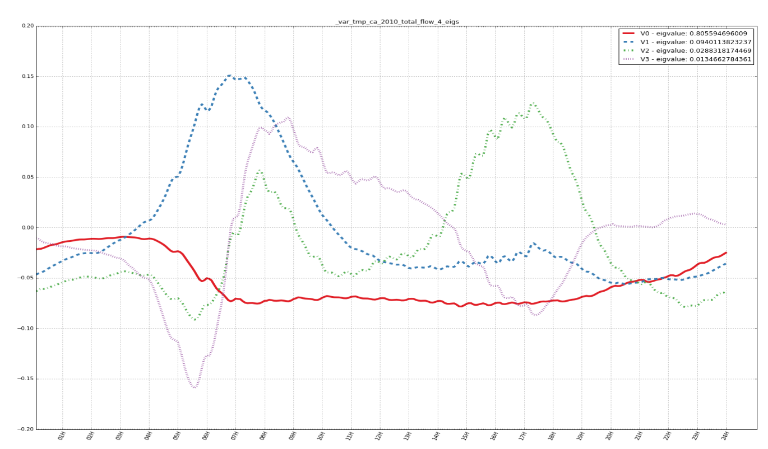
Top Eigen-vectors

Slide 11


Slide 12
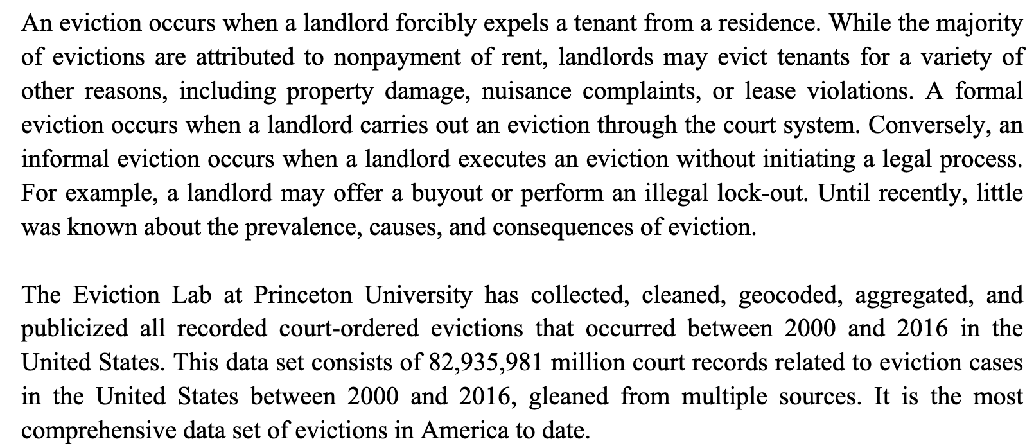
Eviction Labs

Slide 13
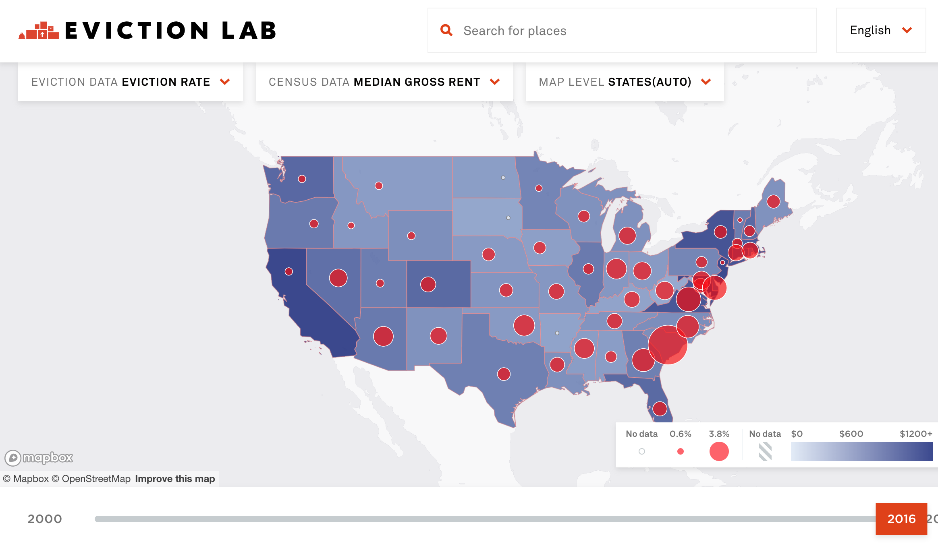
Visualization

Slide 14

Analysis

Slide 15
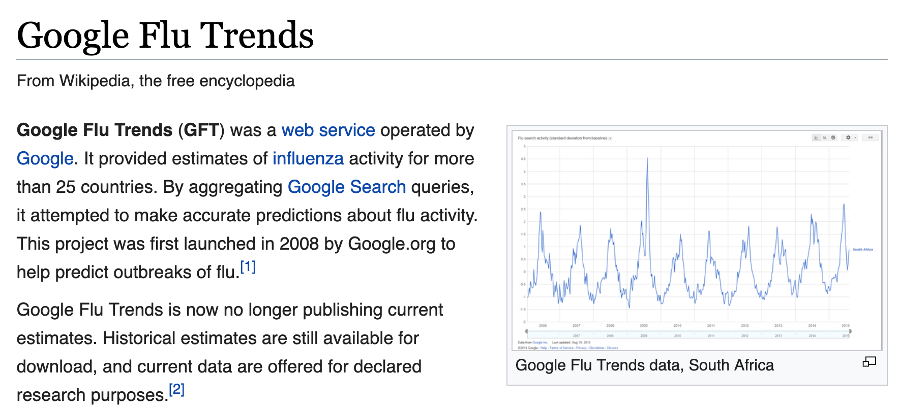

Slide 16


Slide 17
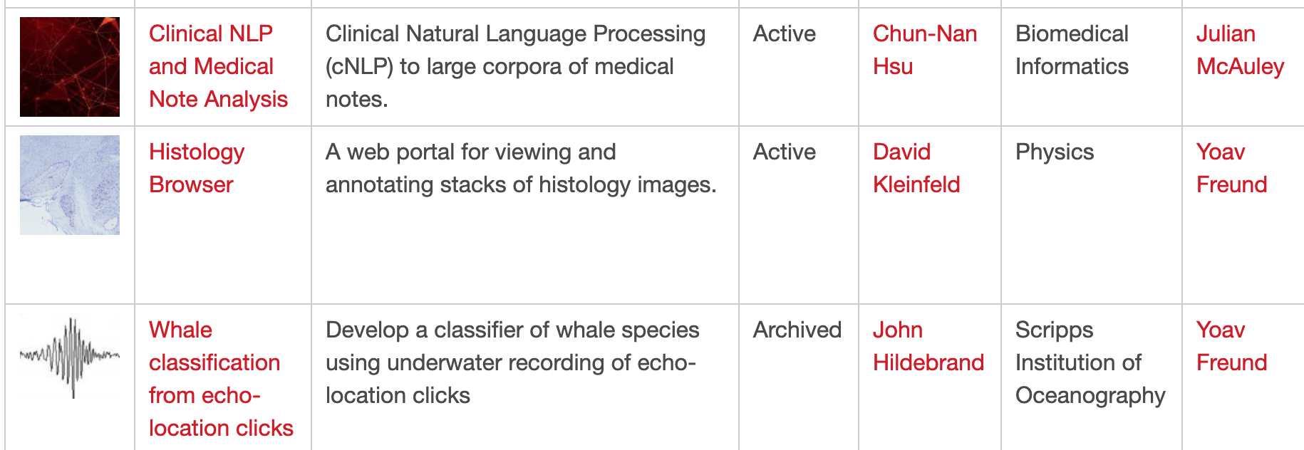
Whale Echo-Location clicks
SDSC Matchpoint (https://datascience.sdsc.edu/matchpoint) is a clearing house for data-science projects.

Slide 18
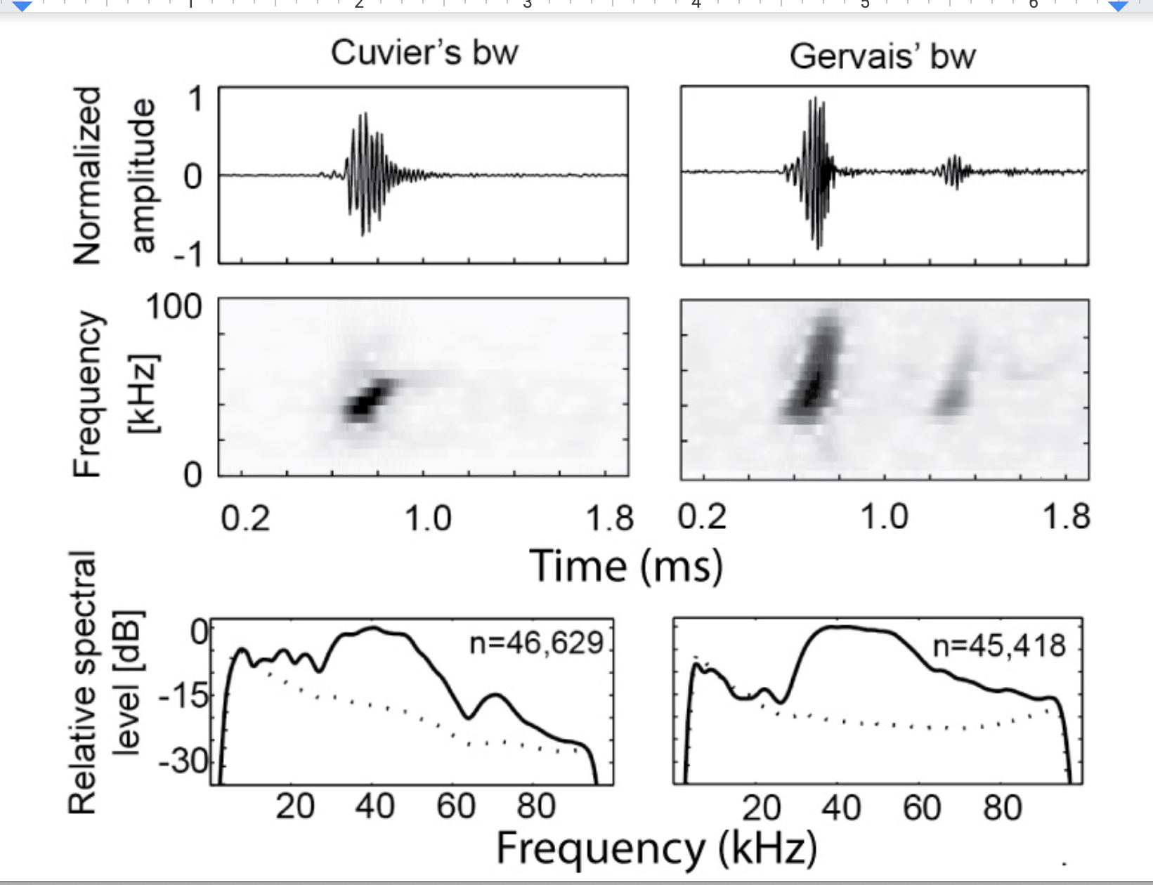

Slide 19
Data from the ocean
Harps and Arps
Continuous recording at 200 Khz
Recorder is retrieved after a year.
Generates 2TB of data
Processing takes about 2 weeks.
Why: throughput of one computer is ~ 100MB/Sec
Using 2 cores helps. More than that : same or worse

Slide 20
What about doing this in the cloud?
Price of processing 1TB:
AWS: a1.xlarge, 0.106$/hour -> 0.34$/TB
Getting the data into the cloud
Through internet, rate varies, around a day per TB (shared expensive resource)
Snowball: 200$ and 1-2 days to transfer 50TB.
4$ to get a TB into AWS S3
Transfer of data from S3 to EC2: 0.01$ – 0.02$ per gigabyte: 10$ - 20$ per TB

Slide 21
When processing big data, communication dominates computation
The CPUs are sitting idle, while the rest of the system struggles to get the data to them.
The memory Hierarchy.
Better to use a lot of simple computers than one powerful super-computer.
Map-Reduce.

Slide 22
What will you learn to compute?
Basic statistics.
Principal components
Clustering
Dimensionality reduction maps.
Computing intrinsic dimension.
Decision trees and boosting
Neural Networks using Tensorflow.

